Slide 1
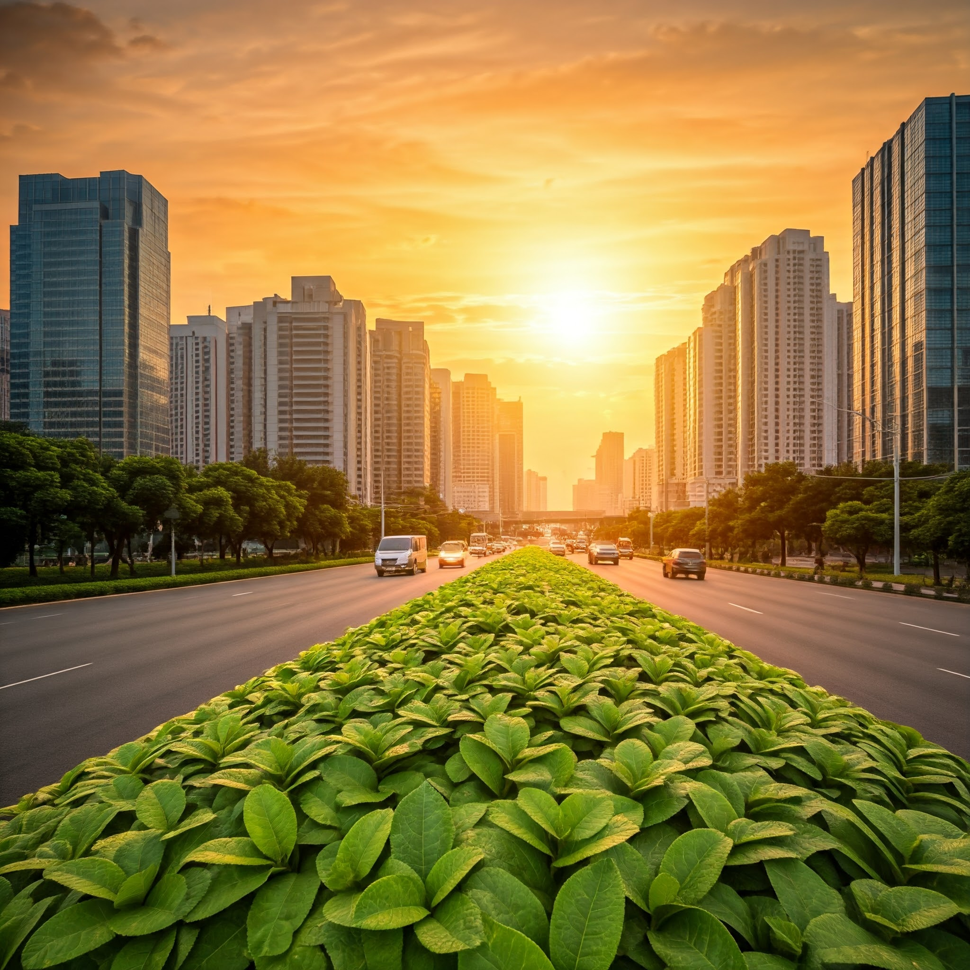


City Design
SWARGANSH
The
Glimpse
Of
Heaven
DESIGNED BY
*Pratik . Ashok . Shetty *Mallikarjun Paroji *Aditya Arasamangallam *Akash Hoasamani

Slide 2
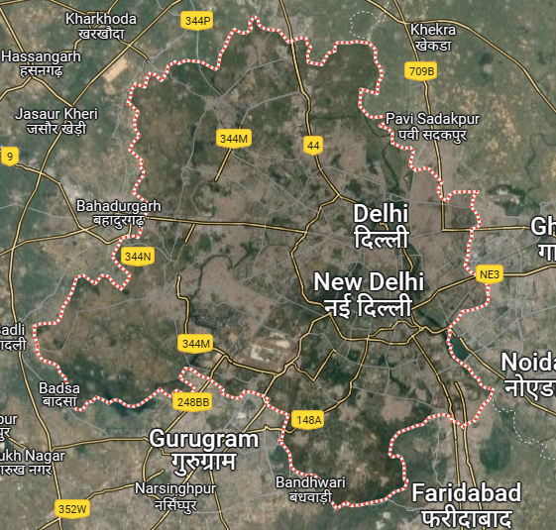
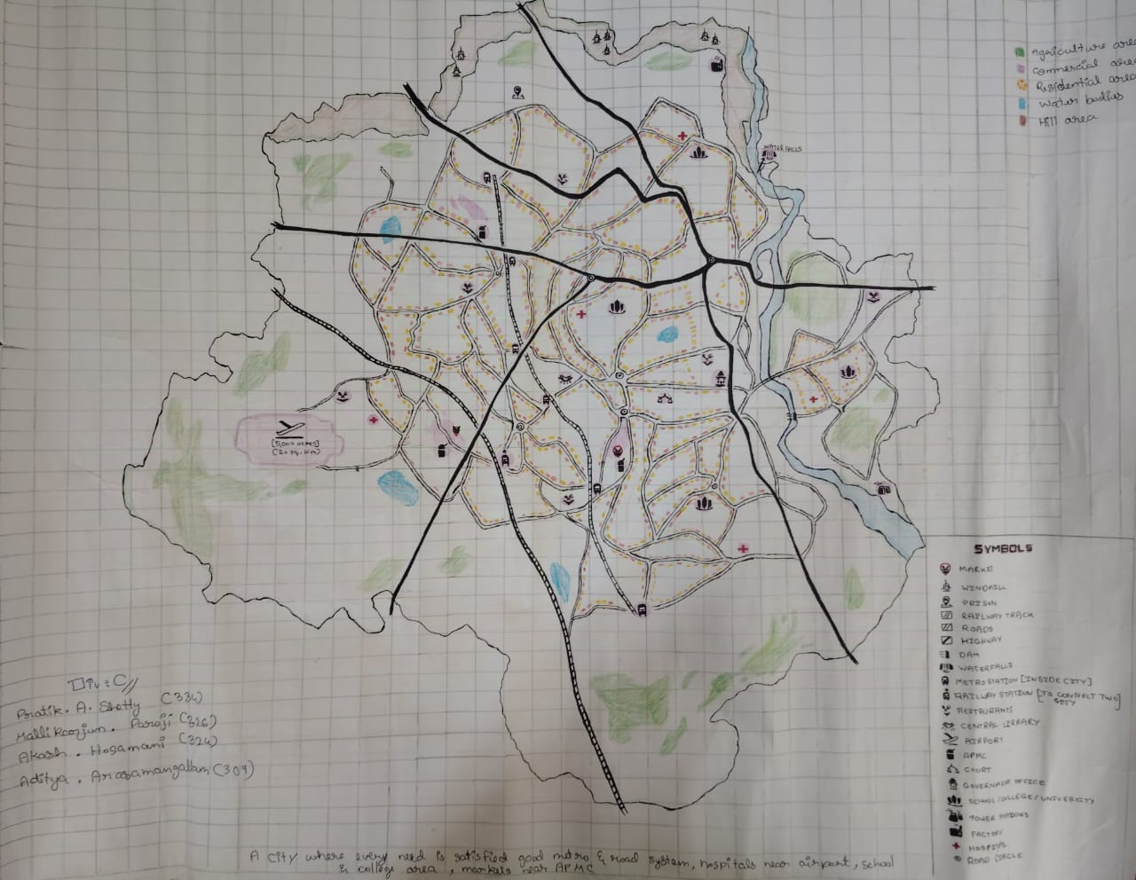
Location:
28.7 degrees N
77.1 degrees E
CITY NAME: SWARGANSH
AREA: 1500 sq.km
PIN CODE: 110001
TIME ZONE: JST(UTC+ 05:30)

Slide 3
Area Distribution:
1.Residential Zone: Around 525 sq. km. of area is used for housing, apartments, and villas. Most of this area is used to build apartments to optimize space usage. There are affordable housing options for mid-income people.
2.Commercial Zone: Approximately 375 sq. km. is dedicated to corporate offices, IT parks, retail outlets, and entertainment areas.
3.Industrial Zone: 250 sq. km. of area is dedicated to industries with an integrated waste management system.
4.Public Spaces: Around 200 sq. km. is reserved for parks, lakes, and rivers.
5.Agricultural Zone: Approximately 150 sq. km. of area will be allocated for agriculture-related activities.

Slide 4
Area Distribution:
AREA | CONSISTS | AREA (IN sq.km) | NUMBER OF BUILDINGS
RESEDENTIAL AREA | House, Apartment, Villas | 525 | 200,000
COMMERCIAL AREA | Offices, Retail Spaces, Markets, Malls, Movie Theatre | 300 | 15,000
INDUSTRIAL AREA | Factories, Power Reactors, Warehouses | 225 | 3,500
EDUCATIONAL AREA | Schools, Colleges, Universities, Library | 10 | 20
AGRICULTURAL AREA | Farms | 150 | 600
PUBLIC INFRASTRUCTURE | Water Park, Tourism Spot, Playground,Hospitals | 50 | 400

Slide 5
Population Distribution:
Residential Areas:2,500,000 people reside in Residential areas.
Commercial Areas:500,000 people reside in commercial areas.
Industrial Zones: 300,000 people will work in industrial zones.
Public Parks:200,000 will visit or live near public parks.
Agricultural Zones: 80,000 people will work or live in agricultural zones.
Government And Other Institutions:200,000 people will be employed in government and other institutions.
Other Migrants: 400,000 visitors, including business travelers, will add to the population.
ANNUAL POPULATION GROWTH OF DELHI: 2.63%

Slide 6
Budget Distribution by sectors:
Residential Area : Construction of apartment, low- income houses.
Commercial Area : It includes construction of business, retail stores, restaurants and other services.
Agricultural Sector : Investment in modern irrigation and forming technologies.
Government Sector : Includes police stations, Courts, Jail, Gov. schools, Gov. Hospitals, DC office.
Industrial Sector : Includes Industries, Factories, Warehouse
Public Spaces : Includes parks, tourism places and other public entertainment things.
SECTOR | BUDGET (IN RUPEES)
Residential Area | 35,000 crores
Commercial Area | 25,000 crores
Agricultural Area | 1,500 crores
Government Sector | 500 crores
Industrial Sector | 15,000 crores
Public Space | 250 crores
Total | 77,250 crores

Slide 7

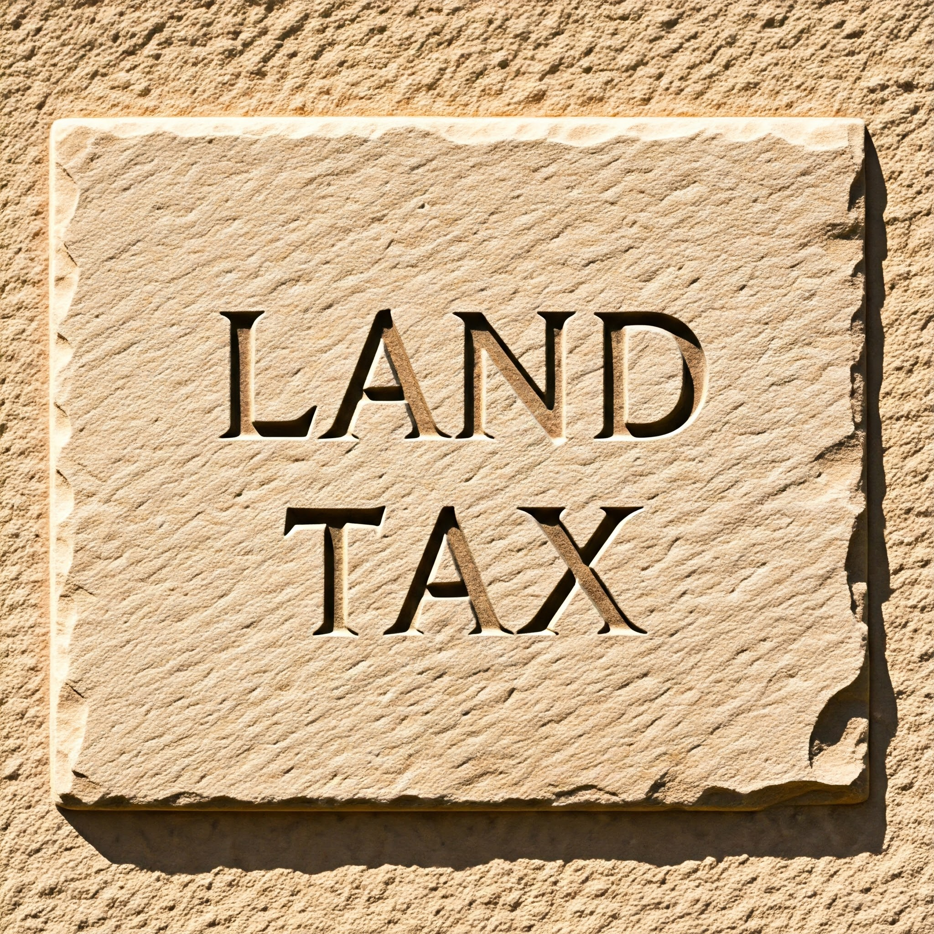
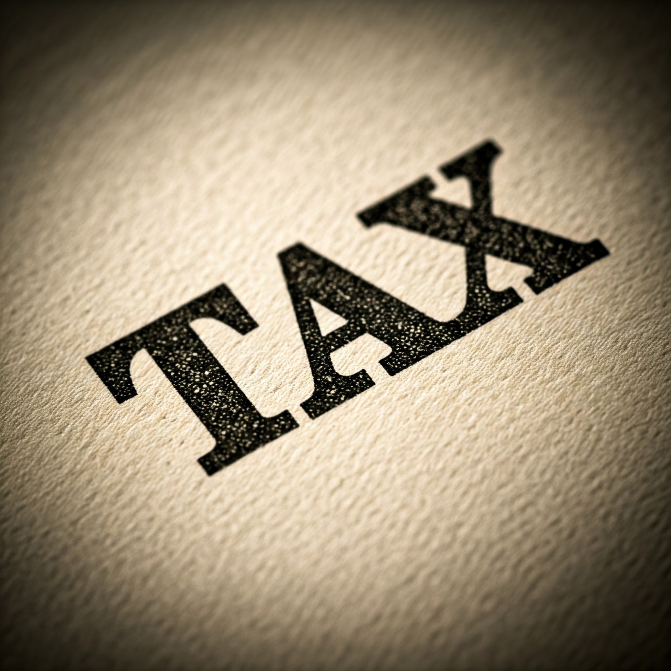

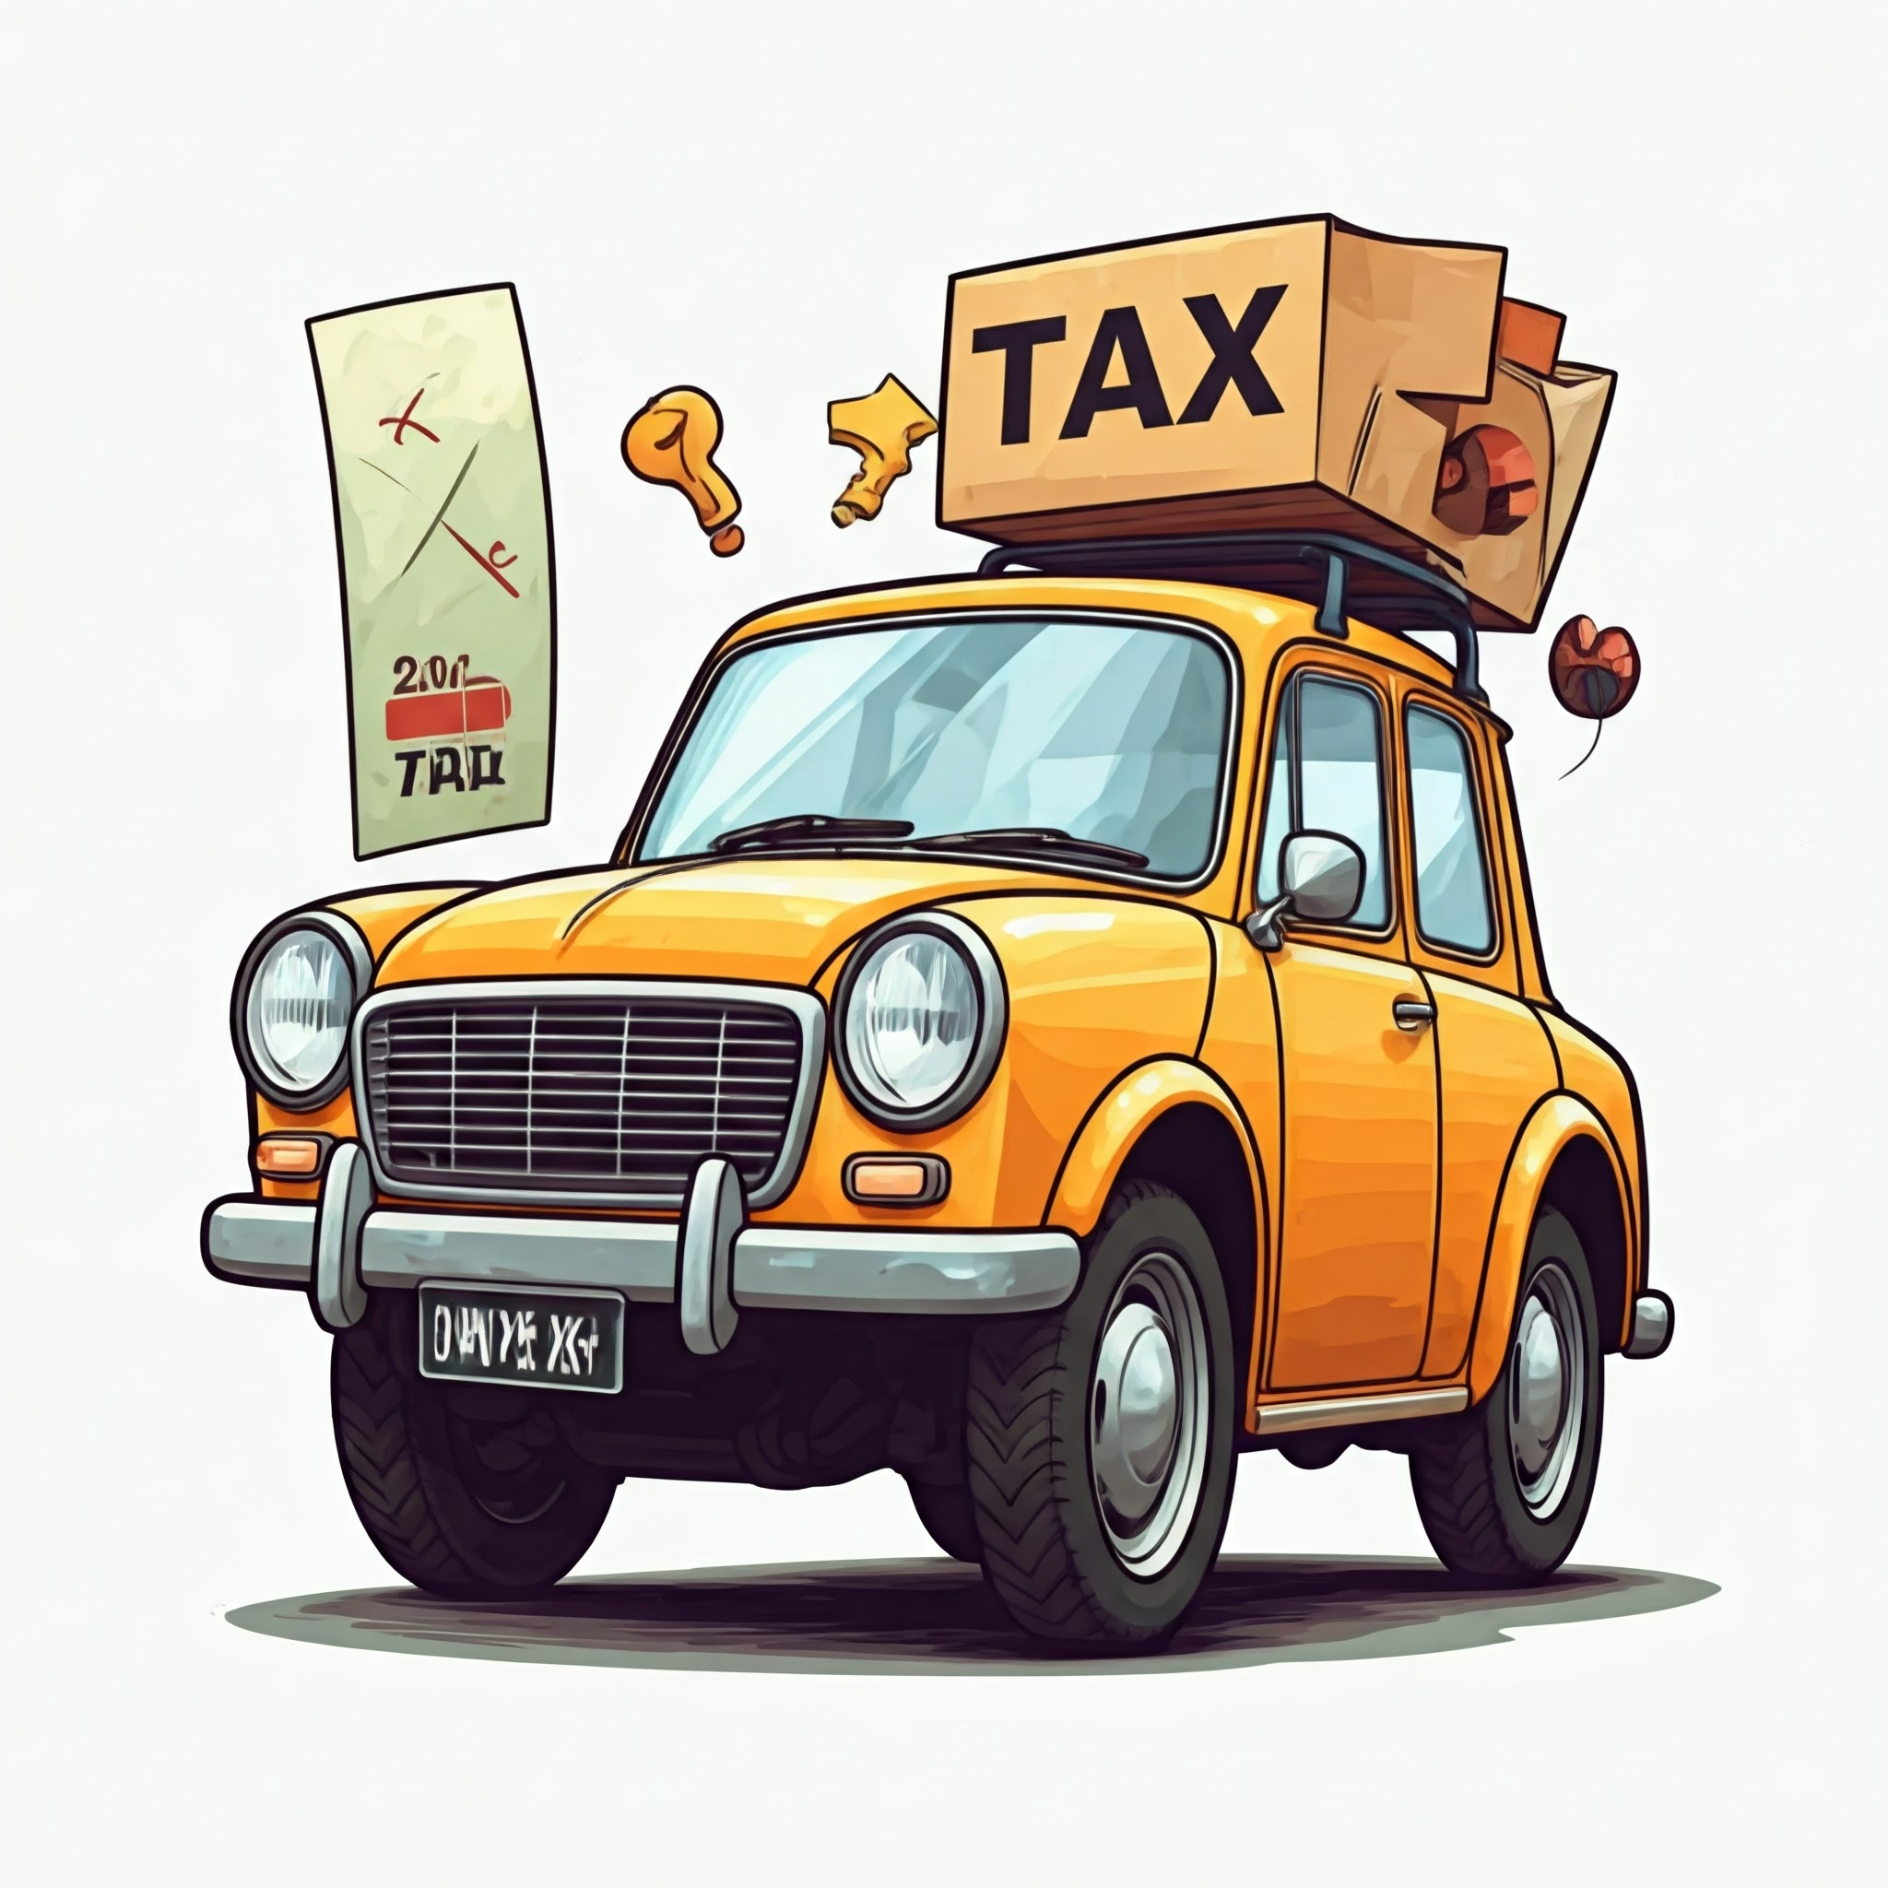
Revenue Models:
1)Property Taxes: The city will impose taxes on both residential and commercial properties. Depending on property use, rates will vary.
Property tax rate: 6% of the annual letting value.
2)Utility Charges: Residents and other sectors will pay for the consumption of utilities such as electricity bills, water bills, and waste management systems.
3)Public-Private Partnerships: The city will sign agreements for long-term profit sharing with investors to fund projects for infrastructure development.
4)Tourism and Real Estate: The city can generate revenue from property sales, leasing, and tourism-related services like hotels and entry fees for tourism spots.

Slide 8
Revenue Models:
5)Sales Tax:
GST on essentials (household goods, agricultural products, restaurant services): 5%
GST on goods like dairy products, textiles, footwear (under price limits): 12%
GST on most goods and services (electronics, snacks, beverages): 18%
GST on luxury items (air-conditioners, cars, certain beverages): 28%
6)Income Tax:
Income up to ₹3 lakh: No tax
₹3 lakh to ₹6 lakh: 5%
₹6 lakh to ₹9 lakh: 10%
₹9 lakh to ₹12 lakh: 15%
₹12 lakh to ₹15 lakh: 20%
Above ₹15 lakh: 30%
Other taxes include taxes on tobacco, vehicles, and businesses.

Slide 9
Revenue Models:
7)Fees and Charges:
International Driving Permit: ₹1,000
Vehicle Registration Fees: ₹200 for two-wheelers, ₹600 for cars
Road Tax: 8% to 22% of vehicle’s value
Land and Property Registration Fees
8)Fines and Penalties:
Revenue generated from violations of city laws and regulations.
9)Inflation:
Average inflation rate in Delhi: 5-6%. Revenue and expenses increase in line with inflation.

Slide 10




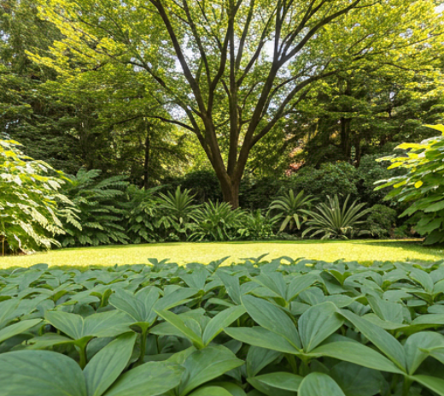
Sustainability Initiatives:
1.Solar Installations: All residential and commercial buildings will have solar installations on rooftops.
2. Windmill Installations:Windmills installation in high ground level and near farms.
3. EV Support: Special discounts will be provided for EV vehicles, and public transport like government buses will be EV-powered and EV station in every 2km.
4.Green Spaces: Around 200 sq. km. is reserved for parks, lakes, and rivers.
5.Hydro-electricity: Dams and Hydro power stations in river .
6.Other new innovations : Described Briefly in Business studies

Slide 11
THANK YOU
All the images used are generated by “GOOGLE GEMINI”.

